Slide 1
Functions/Methods, Scope and structure
CT4019 – Programming and Mathematics for Games

Slide 2
In this session…
Arrays (recap)
Defining and using functions
Passing parameters by reference in C++
Variable scope
Structs and how to use them as POCO’s
Good program structure

Slide 3
Arrays (Recap)
Arrays allow you to declare a variable which will point to more than one value in memory
This is achieved by identifying the type, then giving the variable a name, then either:
two square brackets, with a number inside which identifies how many elements your array will have
Or, two square brackets, followed by an array initialiser that allows the compiler to identify how many elements your array will have
Or, a combination of the two, in which case the number of array elements in the initialiser must not be greater than the number specified

Slide 4
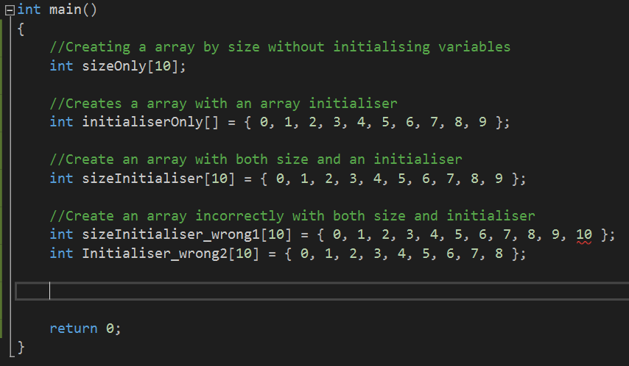

Slide 5
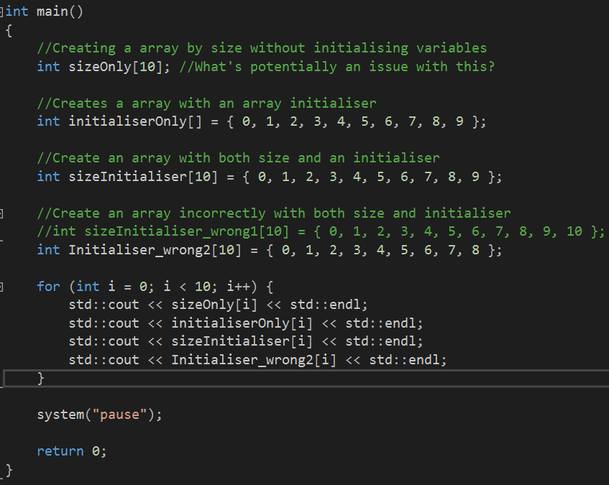
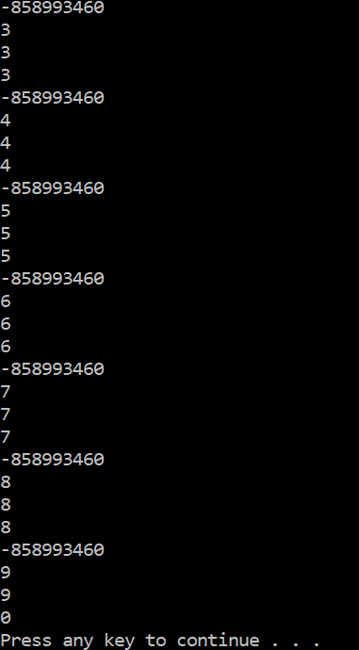

Slide 6

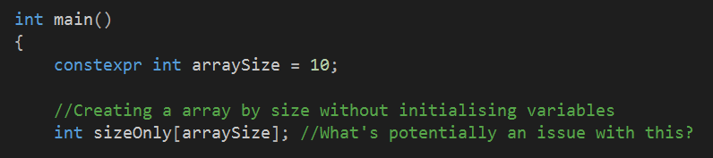
Great – but what about magic numbers?
Magic numbers are numbers typed directly into your C++ code, which, without context mean nothing
And should be avoided wherever possible
So how can we avoid it here? Two methods.
One – the preferred, is to contain the size of your array in a constant in code.

Slide 7

Constant size loop demo
Which will then allow you to use that value in a loop
Alternatively, it is possible to use the C++ function “sizeof” to get the size of an array at runtime
sizeof returns the size in bytes of an type – and each type is usually multiple bytes, so we also need to divide the result by the number of bytes in the type
I.e. an int is (often) 4 bytes long, so an array of ten ints will be 40 bytes long. 40 /4 comes to 10, giving us the correct array length

Slide 8
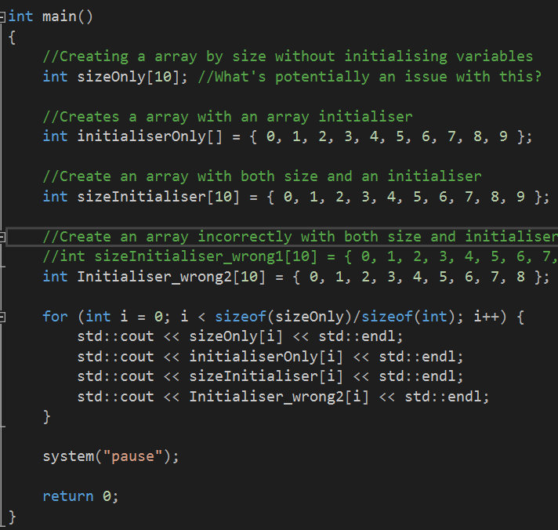
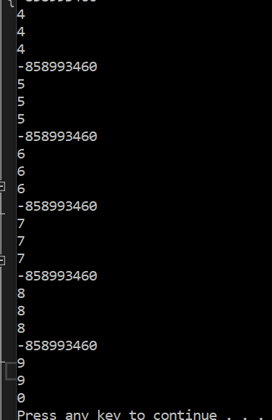

Slide 9
Task #1
Write a C++ program that will populate an array with the numbers from 1 to 100
Modify your program so that it creates a second array with the values 100 to 200
Further modify your program so that it creates a third array, with the contents of the two previous arrays alternated, with the second array in reverse
I.e. 1, 200, 2, 199, 3, 198… and so on
If you used more than one loop to achieve the population of your third array, try to tweak it to work with just one loop

Slide 10
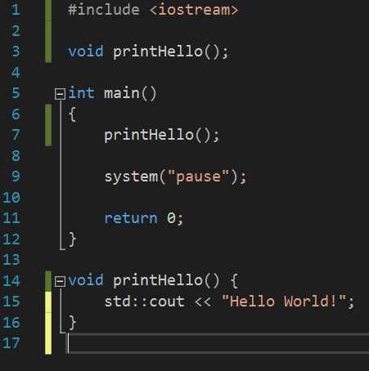
Defining and using functions/methods
In C++ methods are defined by first deciding on a return type, and identifying this
This is the type of value that the method can return
Followed by a method name
Followed by a pair of braces
Inside the braces, a list of parameters that the function can take as input
This must then be put either at the start of the file, or in a header file, as a function prototype or function declaration
The definition of the function follows later, and is comprised of the same line, followed by some curly braces, with the content of the function inside
It is very important that the function prototype and the function definition match.

Slide 11
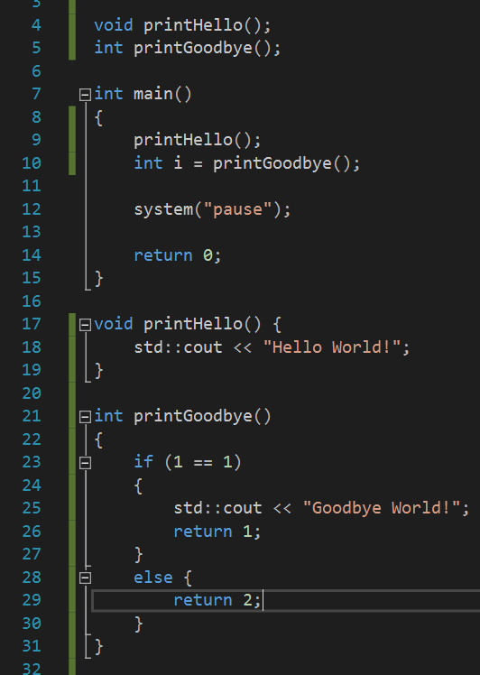
Return types
If a method has a return type, it should return a value of the correct type
C++ is not as strict about enforcing this in the compiler as C#, but you should still try to stick to the rule

Slide 12
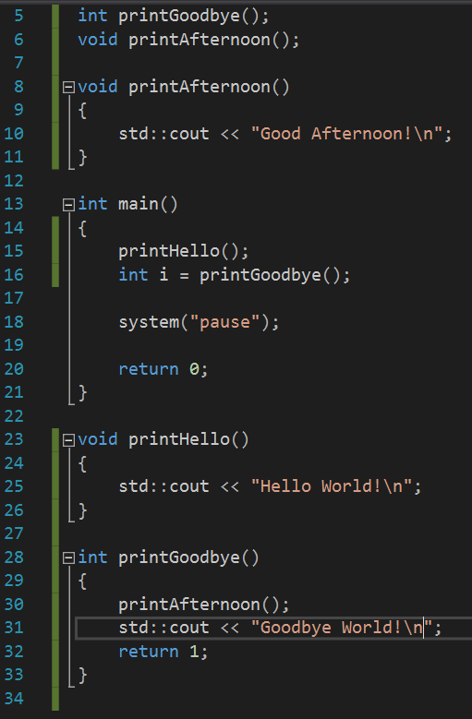
Calling methods
When we call a method, control goes to the method we have called
When that method returns, we drop back to the same spot in our original function, either with or without the value returned (depending on whether there was one)

Slide 13
Calling methods
When you call a method control is passed to that method
It then returns to the calling method
It is up to us whether we use returned values or not (i.e. we don’t necessarily need to supply a variable to store them)
We always need to pass all the expected arguments, however

Slide 14
Task #2
Modify your array manipulation program from the previous task to use different methods for each of the array tasks
When you pass an array as a function argument in C++ you should also pass the size of the array as an integer – otherwise there’s no way for the called function to know the correct size
Write a C++ function that given an array of random numbers (example below), will sort this list into the order smallest to largest (hint: look up bubble sort)
56 | 20 | 1 | 21 | 90 | 101 | 200 | 341 | 249 | 1

Slide 15
Variable scope in C++ basics
When a variable is created inside a code block in a method (usually a set of curly braces {}, like an if statement or a switch statement) it exists only until that code block ends
When a variable is created directly inside the method (i.e. not inside any inner code blocks in that method) it exists until that method ends
Variables declared outside of a method or class or namespace are global
Global variables are bad practice, and we do not use them ever
Variables declared as part of a class exist until that class is destroyed

Slide 16
Variable scope in C++ basics
So if we create a variable inside our if statements executable block, it is only usable inside that execution block, and once our if statement is finished, that variable no longer exists
Similarly if we create a variable inside of a method, it is only usable inside that method, and when the method ends, that variable no longer exists.

Slide 17
Structs and using them as POCO’s
Structs are usually used in C++ as a POCO
Plain Old C Object
Essentially, they are used to store data in a structured way, with no methods or other object orientation paraphernalia
We construct structs with the struct keyword, and then a name, then some curly brackets
Inside those curly brackets, we list all of the variables we want present inside out struct (potentially including other structs)
We access the variables inside a struct using a ‘.’

Slide 18
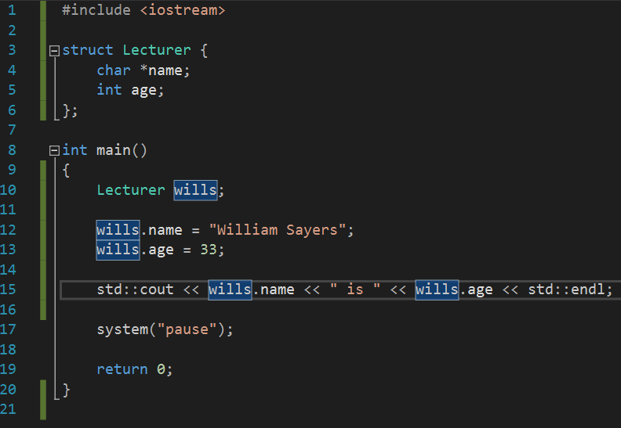
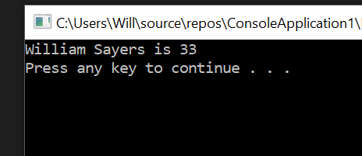
Structs: Example

Slide 19
Recursion
You’ve touched on recursion before – recursion is what happens when a function calls itself
This can give us a very elegant way to solve certain kinds of problems that lend themselves to recursion
A recursive function must always have a “base case” – a case where once a certain condition is hit, the function will not call itself

Slide 20
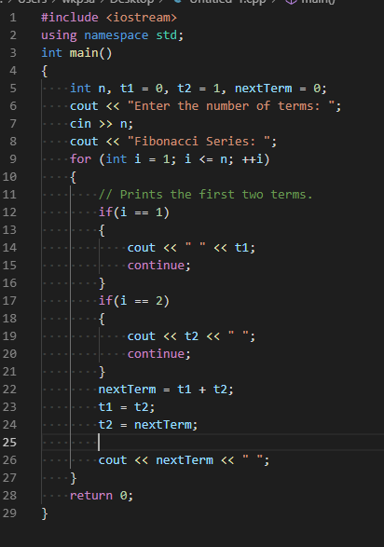
Fibonacci
So for example, the most common example of recursion being more elegant is the Fibonacci sequence – this is a sequence of numbers in maths which goes, 0, 1, 1, 2, 3, 5, 8, 13, 21…
Each number is the sum of the two previous numbers
It can be calculated in code up to a certain number of terms as shown on the right

Slide 21

Fibonacci
We can also calculate it using recursion…

Slide 22
So it’s better?
So, I’m cherry picking to make a point. You can have a neater iterative solution, you could also make a less tidy recursive solution.
But it’s not possible to make the iterative method as clean as the recursive method is in code
In terms of performance – the recursive method is far worse as presented here
There are ways to make it better – by using dynamic programming and memoization

Slide 23
Any Questions?

Slide 24
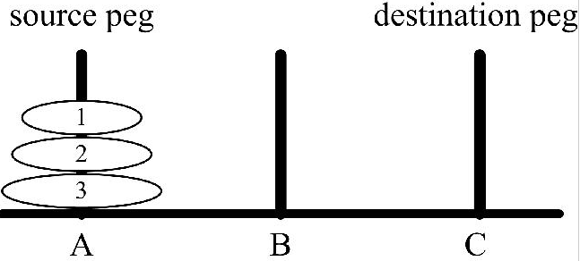
Final Task / Practical
The towers of Hanoi is a problem invented by a mathematician
You have three pegs, A, B, C
One of the pegs (A) contains a set of discs stacked to resemble a tower, with the largest disk at the base and the smallest on top

Slide 25
Final Task / Practical
The goal is to move the discs from peg A, to peg C
Only one disk may be moved at a time
Each move consists of taking the upper disk from one peg, and placing it onto another peg (i.e. only uppermost disks can be moved)
A larger disk may not be placed on top of a smaller disk during transfer

Slide 26
Pseudo-Code
TOH( n, Sour, Aux , Des)
If(n=1)
Write ("Move Disk “, n ," from ", Sour ," to ",Des)
Else
TOH(n-1,Sour,Des,Aux);
Write ("Move Disk “, n ," from ", Sour ," to ",Des)
TOH(n-1,Aux,Sour,Des);
END

